Slide 1
ROOT CAUSE COUNTER MEASURE
Solving Problems with RCCM

Slide 2
PURPOSE, OBJECTIVES, SCOPE, CHALLENGES
PURPOSE AND BENEFITS
Develop a common problem solving language, pertinent to all functions across the company
Get to the underlying cause of a problem, rather than treat the symptom and fail to get results
Avoid “Ready, Fire, Aim”
Harness our “Bias For Action” into fact-based problem solving”
Expected Benefits:
  Improved SQDCC, Growth and Innovation.
  Speed of problem resolution
LEARNING OBJECTIVES
Learn the 8 steps for an effective root cause counter measure process
Understand the resources required, and how to evaluate the effectiveness
Learn methods for leadership and owners to verify and sustain the process
SCOPE
Module Addresses: The eight steps involved in the root cause counter measure process
Out of Scope: Does not include other applications of A3s such as project management
CHALLENGES TO OVERCOME
Absence of data to clearly understand the problem
Jumping to solutions before clearly understanding the problem and root cause
Lack of follow through to ensure results are achieved and leveraged across the organization
Local expertise to support ongoing activity
Cultural “Bias For Action” that historically acts without clear understanding of root cause… Hesitancy to “go slow to go fast”
Typical A3 tackles entire “Gap” leading to narrow results and “bogging down”
Focus On Solving Root Causes To Improve SQDCC

Slide 3
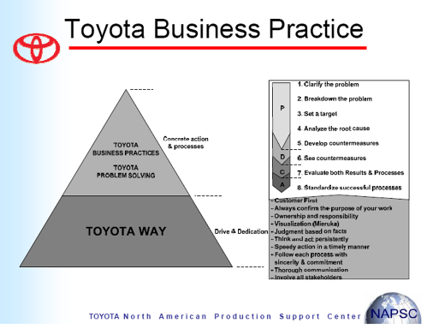
BASED ON TOYOTA PRODUCTION SYSTEM(TPS)
Toyota Production System
SMART’s 8-Step RCCM Process Is Modeled After Toyota
3

Slide 4
WE NEED TO SOLVE PROBLEMS
My job is to improve everyday, uncover problems, help find WHY it went wrong and communicate the issue as often as it takes to get action
Employees are trained as problem solvers and inspectors of their output….
  To assure we make the correct decisions at the point of use, we use a process of 8-Step Root Cause Countermeasure

Slide 5
DEFINITION OF 8-STEP RCCM
What is an 8-Step RCCM?
  8-Step RCCM is a problem solving process designed to guide the user toward solving smaller portions of the larger “Gap”
  Genchi Genbutsu at the Gemba - “Go and See for Yourself to confirm the Prioritized Problem at the Point of Occurrence”
Point of Occurrence
Point of Detection
“Data Is Important, But I Place The Greatest Emphasis On Facts” –Taiichi Ohno
Notes:
5

Slide 6
DEFINITION OF A PROBLEM
What is Your definition of a Problem?

Slide 7
DEFINITION OF A PROBLEM
Problem is the gap between “Ideal Situation” and “Current Situation”
Ideal Situation
GAP
Gap=Problem
(Visualization)
Current Situation
Problem Solving is closing the gap!

Slide 8
DEFINITION OF A PROBLEM
Ideal Situation
On Time Delivery at
90%
Problem
GAP
OTD is 10%
Under Ideal
On Time Delivery at
80%
Current Situation

Slide 9
How Do You Find Problems?
SURFACING PROBLEMS
Key Performance Indicators (KPIs)
Deviation from established standards
Comparing activity to Annual Transformation Plan
Andon Pulls
Customer Complaints
Visual Control Boards
Gemba Walks
There is
No Shortage
of Problems!

Slide 10
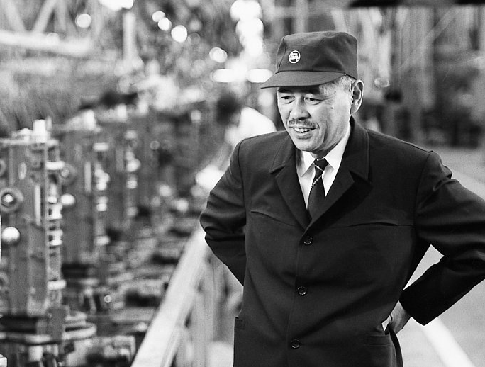
SURFACING PROBLEMS
“No one has more trouble than the person who claims to have no trouble.”
(Having no problems is the biggest problem of all)
by Taiichi Ohno

Slide 11
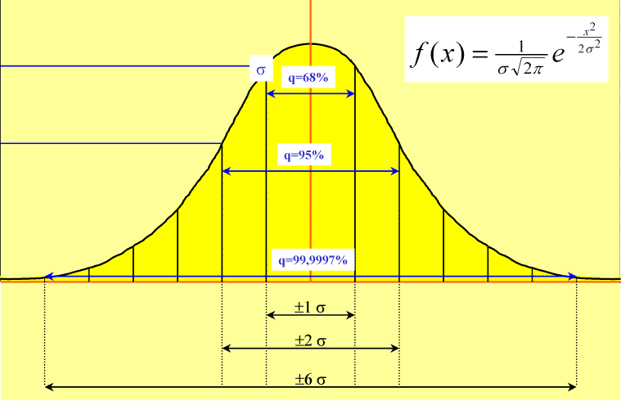
RCCM USES MULTIPLE PROBLEM SOLVING TOOLS
OpEx Thinking
  Create flow
  Eliminate waste
  Uncover problems
The Problem Solving process will address issues that occur in the 7 Disciplines.
8-Step RCCM
Problem Solving
  Genchi Genbutsu at Gemba
  Solve prioritized “Gap”
  Yokoten (Sharing lessons learned)
6-Sigma
Capablity & Variation
  Improve process capability
  Eliminate variation
  DMAIC
OpEx Applies The Most Appropriate Toolkit To Resolve Problems.

Slide 12
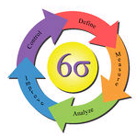
DEFINITION OF 6-SIGMA
WHAT IS 6-SIGMA?
A process within lean improvement
  Define what’s important
  Measure how we’re doing
  Analyze what’s wrong
  Improve by fixing what’s wrong
  Control to guarantee performance
Tools targeted at improving process capability and variation
  Cause & Effect
  Measurement Systems Analysis (MSA)
  Capability Study
  Failure Modes Effects Analysis (FMEA)
  Design of Experiments (DOE)
6-Sigma is literally defined as 3.4 defects per million
  4-Sigma is 99.4% (6,210 defects per million / PPM)
  5-Sigma is 99.977% (233 defects per million/PPM)
  6-Sigma is 99.9966% (3.4 defects per million/PPM)
RCCM 8-Step And 6-Sigma Assure Effective Problem Solving

Slide 13


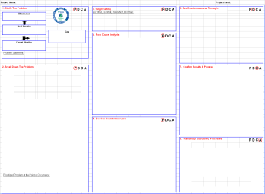
8-STEP RCCM FRAMEWORK
CHECK
PLAN
DO
ACT
STEP #1: CLARIFY THE PROBLEM
The problem is the gap between our current and ideal state of performance.
STEP #2 BREAK DOWN THE PROBLEM
Prioritized Problem at the Point of Occurrence
Genchi Genbutsu at the Gemba – “go see with your own eyes at the place the work is done”
STEP #3: TARGET SETTING
Do what, to what, how much, by when?
STEP #4: ROOT CAUSE ANALYSIS
Brainstorm and investigate causes
5 WHY’S
STEP #5: DEVELOP COUNTER-MEASURES
Linked and prioritized for each root cause
STEP #6: SEE COUNTER-MEASURES THROUGH
Create a clear and concrete plan that includes ‘who’, ‘when’ and ‘status’
Take actions to eliminate the root cause
STEP #7: MONITOR RESULTS & PROCESSES
Measure results to assure repeatable successes
Measure the impact to the gap created in Step 1
Understand and learn from both successes and failures
Add layered audit process
STEP #8: STANDARDIZE SUCCESSFUL PROCESSES
Standardize and communicate success
Yokoten – The process for sharing improvements across the organization
Tell the problem solving story using the RCCM A3 form
Follow The PDCA Cycle
13
Notes:
13

Slide 14

BLANK 8-STEP RCCM A3
8-Step RCCM A3’s may be computerized, however hand written is fine and actually encouraged; beauty is not important, content is!
8-Step RCCM A3 Tells A Story Everyone Can Understand
14

Slide 15
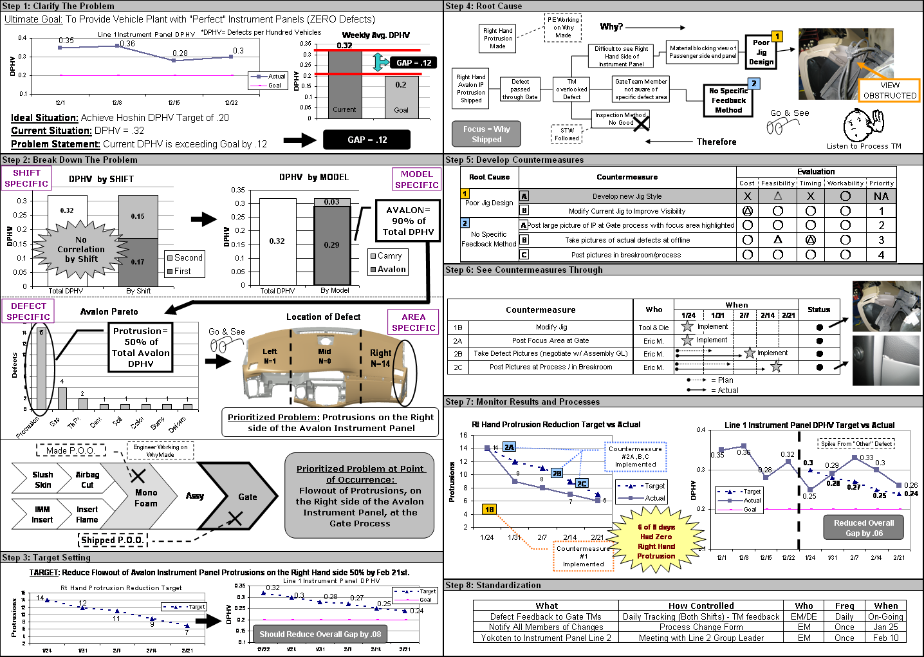
EXAMPLE OF AN 8-STEP RCCM A3
Straight-Forward Process With Everything Fitting On One Page

Slide 16

TYPICAL 8-STEP RCCM WORKSHOP
Two day work shop held on site, with participants addressing current problems of the hosting site/GBU
Teams of 4-6 individuals use the 8-Step RCCM process to address the pre-identified problems
“Train The Trainer” leaders are identified at each site. He/she must attend two 8-Step RCCM classes and then teach a class.
After the workshop concludes, site/GBU leadership then has ongoing reviews of the RCCM A3s in progress to ensure successful completion
The Workshop’s Hosting Site Benefits From Problem Solving Support

Slide 17
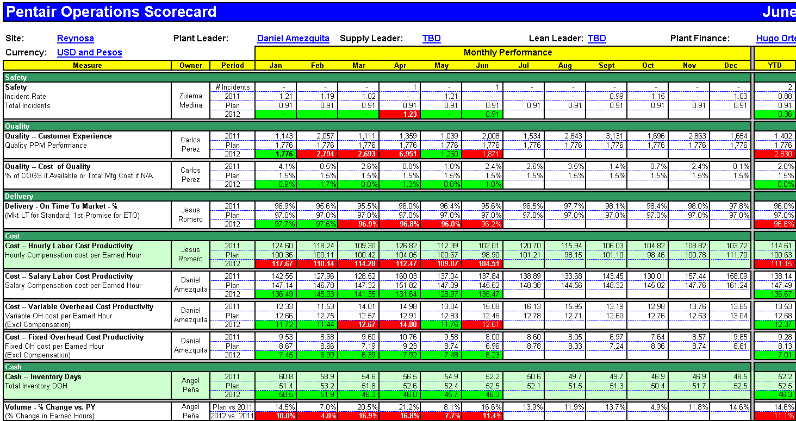


TYPICAL 8-STEP RCCM APPLICATIONS
Strategy Deployment – Bowling Chart & Scorecard Example
Utilize 8-Step RCCM:
  When a scorecard metric does not meet goal for 2 or more consecutive months.
SMART Transformation Plan – Kaizen Results Example
Utilize 8-Step RCCM When:
  The transformation plan activity does not achieve improvement goals.
  Kaizen actions are not proving effective
Strategy Deployment and Transformation Requires RCCM
17

Slide 18
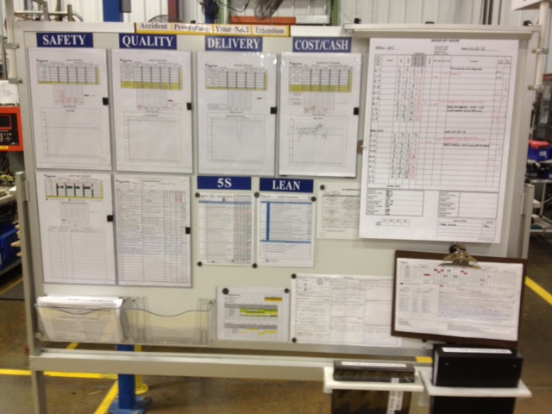

TYPICAL 8-STEP RCCM APPLICATIONS
Managing Daily Improvement (MDI) – Countermeasure Example
If a process is not performing to goal, countermeasure(s) must be created.
RCCM 8-STEP should be utilized when:
    Countermeasure(s) implementation will exceed 30 days
    And/or
    Countermeasure activity will require cross functional support
RCCM Drives True MDI
18

Slide 19
TYPICAL 8-STEP RCCM APPLICATIONS
Customer Complaint – Corrective Action Request (CAR) Example
Customer requested corrective action can be addressed with 8-Step RCCM
The RCCM process can be applied to a customer’s Corrective Action Request (CAR) process
Requests For Corrective Action Requires RCCM
19

Slide 20
SMART’S 8-STEP RCCM PROCESS
Step 1. Clarify the Problem
Step 2. Break Down the Problem
P
Step 3. Target Setting
Step 4. Root Cause Analysis
Step 5. Develop Countermeasures
D
Step 6. See Countermeasures Through
C
Step 7. Monitor Both Results and Processes
A
Step 8. Standardize Successful Processes
The 8-Steps Follow The Plan-Do-Check-Act Approach
20

Slide 21
STEP 1: CLARIFY THE PROBLEM
The Problem should be evident to the reader after they review Step 1.
Ask yourself: “If I am not there to explain it, can it be understood?”
21
Notes:
21

Slide 22
STEP 1: CLARIFY THE PROBLEM
Ideal State
The “Gap”
Improving
Current State
A graph visualizes the “Gap” over a period of time and shows process variation. 6-Sigma tools can help clarify, identify, control and reduce variation.
This step sets the stage for all follow-on activity.
Everyone Must Clearly Understand The Problem
22

Slide 23
STEP 1: CLARIFY THE PROBLEM
Make ambiguous problems clear
Ultimate Goal
Am I
actually contributing
to the
ultimate
goal?
Ideal Situation
Visualizing
（Making Explicit）
What
is the
ideal
situation?
Gap=Problem
GAP
Current Situation
Brief Problem Statement

Slide 24
How Do You Eat an Elephant?

Slide 25
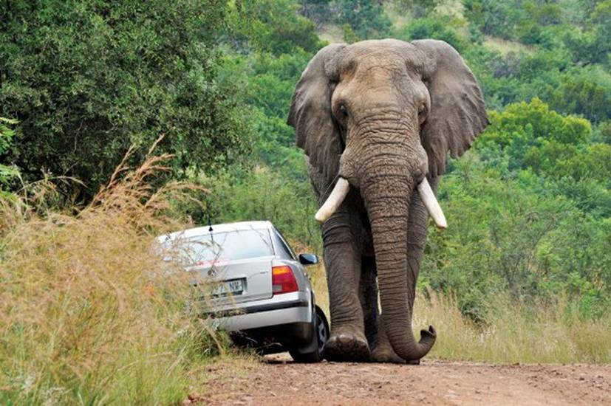

Slide 26
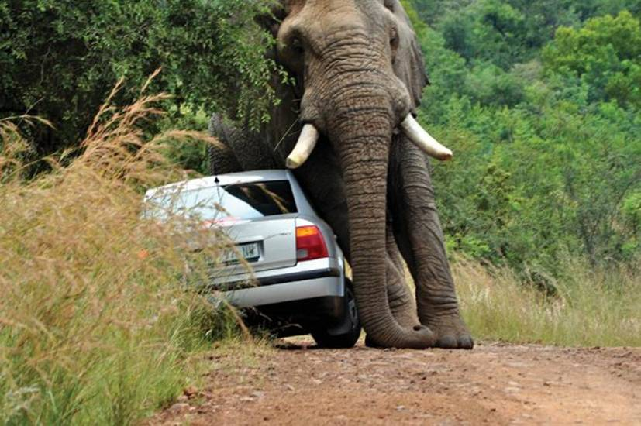

Slide 27
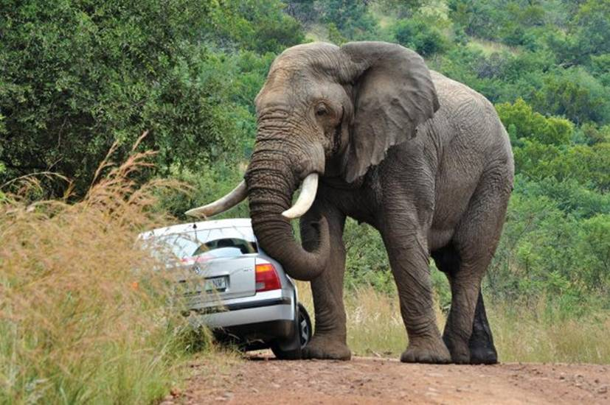

Slide 28
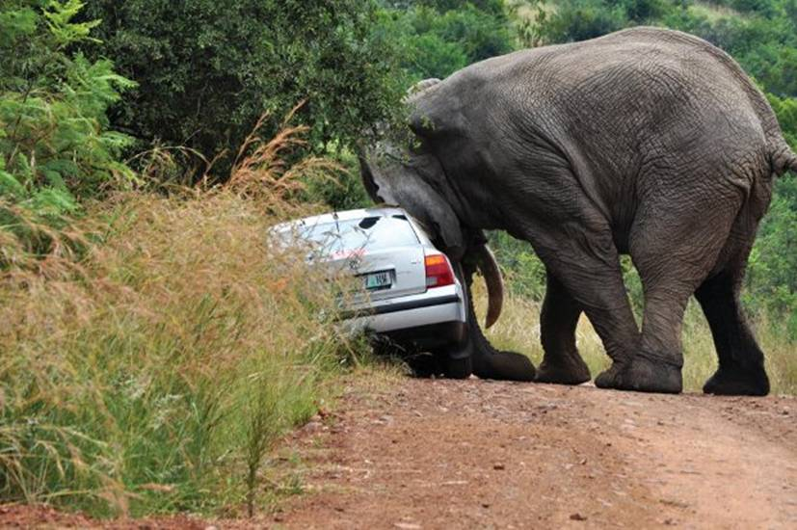

Slide 29


Slide 30
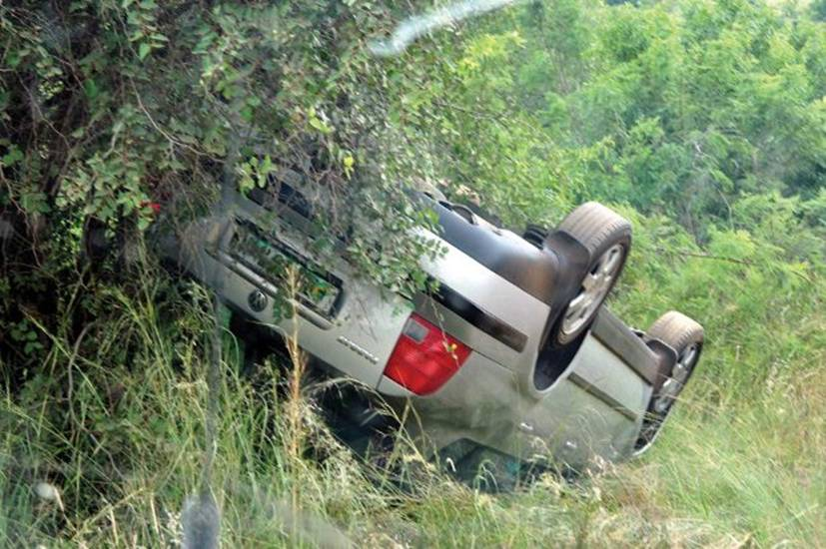
ONE BITE AT A TIME!!!

Slide 31
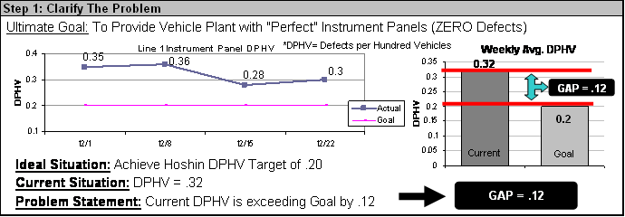
Step 1: Clarify the Problem – Toyota Example
The Problem should be evident to the reader
after they review Step 1. Ask yourself: “If I am
not there to explain it, can it be understood?”
*While this example is a computer version, hand written is fine, and actually encouraged; Pretty is not important, content is!

Slide 32
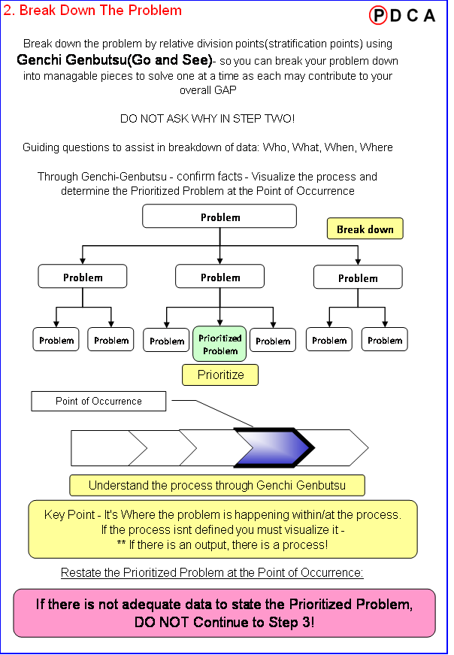
STEP 2: BREAK DOWN THE PROBLEM
One approach for Breaking Down the Problem is to use a Logic Tree as demonstrated here.
32
Notes:
32

Slide 33
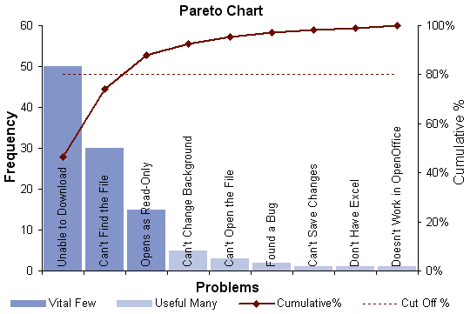
STEP 2: BREAK DOWN THE PROBLEM
Discover And Pursue The “Left Side Of the Pareto” – Focus On The Biggest Issues
A second approach for Breaking Down the Problem is to use a Pareto Analysis as demonstrated here.
1st Pareto graph presents high level issues, a 2nd level drills down problem
PARETO: 80% Of The Opportunities Come From 20% Of The Problems
33
Notes:
33

Slide 34
STEP 2: BREAK DOWN THE PROBLEM
Based on FACTS; Break down the problem
and clarify the Prioritized Problem at the Point of Occurrence
Answer:
What? Where?
When? Who?
Large / Vague Problem (GAP)
Break down
Problem
Problem
Prioritized
Problem
Problem
Break down
Establish
Priorities
Problem
Problem
Problem
Problem
Problem
Problem
Problem
Problem to Pursue
Point of
Occurrence
Confirm facts through
checking the processes
(GENCHI GENBUTSU)
DO NOT ASK WHY YET!!

Slide 35
STEP 2: BREAK DOWN THE PROBLEM
Other commonly used division points
Problems about business
Logistics, research, development, procurement, production, sales, after maintenance, system, people, corporate culture
Problems about people
Knowledge, skills (technology), attitude & motivation
Problems of production
4M (Man, Machine, Material, Method)
Quality, Cost, Delivery
Problems about sales
4P (Product, Price, Place, Promotion)
Problems about resources
People, goods, money, information
Problems about work procedure
PDCA (Plan, Do, Check, Action)
Input, process, output
Problems with some constituent factors
Profit=sales and cost
Productivity=amount of input and output
Efficiency=volume of work and work speed

Slide 36
STEP 2: BREAK DOWN THE PROBLEM
Break down the problem “Products are not selling well”
Division by Region
Division by Product
No Correlation by Region
Product A
Product B
Region 1
Region 2
Region 3
Region 4
Product C
Product D
Product that has been purchased
Product that has NOT been purchased

Slide 37
STEP 2: BREAK DOWN THE PROBLEM
Multiply division points when you cannot think of a single “effective division point”.
The problem - “Home electric appliances are not selling well.”
By area | # of appliances
Eastern | 70
Western | 62
Southern | 83
Northern | 79
Total | 294
No clear differences
Monthly Sales
By product | # of sales
Digital camera | 108
Video camera | 88
TV | 98
Total | 294
Area Product | East | West | South | North | Total
Digital camera | 23 | 29 | 29 | 27 | 108
Video camera | 25 | 9 | 29 | 25 | 88
TV | 22 | 24 | 25 | 27 | 98
Total | 70 | 62 | 83 | 79 | 294

Slide 38
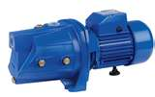
Step 2: Break the Problem Down – Pump Example
Answer:
What? Where?
When? Who?
150 Defects
Pump Type
25 Pump A
50 Pump B
75 Pump C
10
Lt Hand
10
Center
20
Rt Hand
Defect Type
12 Low
Pressure
40
Cracked
23
Mis-wire
Location
Prioritized Problem at Point of Occurrence:
Cracks are occurring on Pump C, RH Side,
At Process #4
Point of Occurrence:
Process
1
Process
2
Process
3
Process
4
Inspect
Notes:
38

Slide 39
Step 2: Break the Problem Down – Toyota Example
Find The Prioritized Problem
At The Point of Occurrence
Then Locate the Point of Occurrence…..

Slide 40
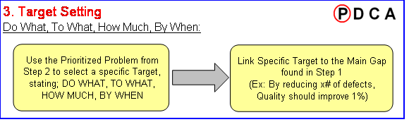
STEP 3: TARGET SETTING
Do What?
To What?
How much?
By when?
Does the Target I have selected link to the Gap from Step 1?
Is it quantitative, detailed and challenging enough?
Prioritized Problem to Pursue
Challenging And Prompt Resolution To Smaller Part of “Gap”
40
Notes:
40

Slide 41
Set Measurable, Concrete & Challenging Targets
STEP 3: TARGET SETTING
 | R&D Example | Sales Example | HRD Example
Gap | Product development time exceeds Ideal time by 2 months | Domestic sales are 20% Less than Ideal | Training course participants are 30% Less than Ideal
Unsuitable Target | Shorten new product development time by 2 months | Increase domestic sales 10% | Increase number of training course participants by 4/1
Suitable Target | Reduce the “Design” Stage length of development time, 1 month, by 4/1 | Increase domestic sales 10%, in the “A” region, by 4/1 | Improve the number of training program non-participants because of “too busy” or “not-important” reasons 10% each by 4/1

Slide 42
STEP 3: TARGET SETTING
Common Mistakes in Target Setting
Confusing “Countermeasure” with the target
Confusing the “method” with the target
Confusing the “ideal situation” with the target
Trying to match the “Gap” from Step 1
Try to avoid vague words !
Implement ---
Consider ---
Support ---
Coordinate ---
Try to ---
…etc.

Slide 43
Step 3: Target Setting – Toyota Example
Step 3: Target Setting Example
Do What?
To What?
How Much?
By When?
Specific Target
Linked to Main Gap

Slide 44
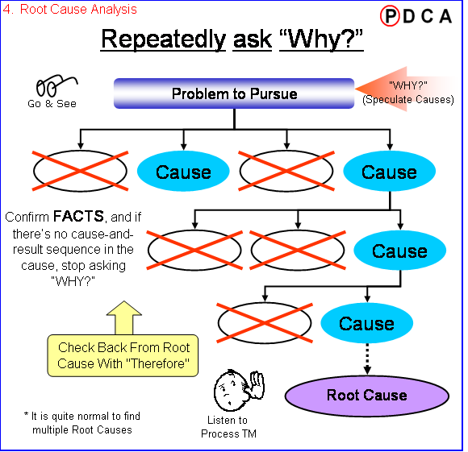
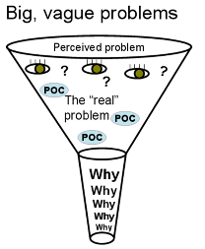
STEP 4: ROOT CAUSE ANALYSIS
Root Cause Assessment Is Critical Step… Identify Biggest Cause
44
Notes:
44

Slide 45

Consider Causes without Prejudice
STEP 4: ROOT CAUSE ANALYSIS
Without bias or any preconceived notions, brainstorm as many reasons for the problem’s development.

Slide 46
Why Sequence
Water leak at lower right-hand corner of windshield on 23% of cars this morning
Why?(Investigate - Experienced inspectors check cars leaving body weld section )
There are pinholes in welds on cars leaving body weld
Why? (Investigate - Based on their location, the welds are traced to one robot)
Robot #3 is burning through the center of welds
Why? (Investigate - Temperature of Robot #3 compared to other robots)
  Welding temperature of Robot #3 is too hot
  Why? (Investigate - Test thermostat and power circuitry of Robot #3)
  Thermostat on Robot #3 malfunctions
  Why? ( Investigate - Observe voltage meter)
    Power surges affect Robot #3
    Why? (Investigate - Check for surge protector on Robot #3)
    No surge protector on Robot #3

Slide 47
Why Verification
Water leak at lower right-hand corner of windshield on 23% of cars this morning
Therefore
There are pinholes in welds on cars leaving body weld
Therefore
Robot #3 is burning through the center of welds
Therefore
  Welding temperature of Robot #3 is too hot
  Therefore
  Thermostat on Robot #3 malfunctions
  Therefore
      Power surges affect Robot #3
      Therefore
      No surge protector on Robot #3

Slide 48
Step 4: Root Cause Analysis – Toyota Example
In this example there were two Root Causes found:
Remember to show all causes investigated, along with the Root Causes.
Work backwards from the root cause asking “Therefore” to confirm
your thought process.
Checkpoint: Occasionally ask someone outside of your area to review the 8 step report. Your target is not only to solve the problem, but to tell a story an outsider can understand.

Slide 49
STEP 5: DEVELOP COUNTERMEASURES
Focus Counter Measures On Biggest Root Cause(s)
49
Notes:
49

Slide 50
STEP 5: DEVELOP COUNTERMEASURES
Temporary Countermeasure
Reverse a negative situation, establish containment or temporarily return to normal or standard
Permanent Countermeasure
By addressing root cause, prevents problem from recurring
Notes:
50

Slide 51
STEP 5: DEVELOP COUNTERMEASURES
Brainstorming Tips
1. No criticism (Don’t judge)
2. Welcome unusual ideas (share ideas off top of the head, accept even thoughtless or illogical ideas)
3. Focus on quantity (generate as many ideas as possible)
4. Combine and improve ideas (ideas can be combined to lead to a good idea)
Rules

Slide 52
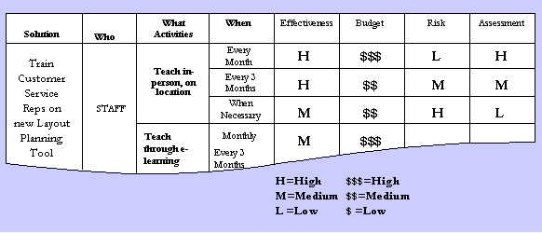
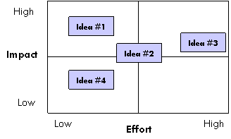
STEP 5: DEVELOP COUNTERMEASURES
Evaluate Countermeasures based on criteria such as; Cost, Timing,
Feasibility, etc.
Prioritize
Select the C/Ms to
implement
Ask yourself: Will this countermeasure create a new problem?
Ask yourself: Will this countermeasure truly fix the root cause?

Slide 53
Step 5: Develop Countermeasures – Toyota Example
Link Countermeasures to Root Cause from Step 4
Evaluate and Prioritize

Slide 54
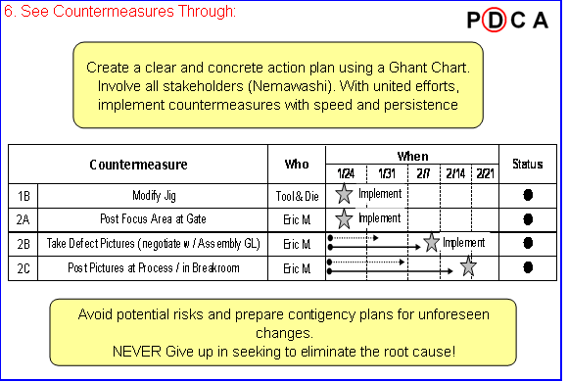
STEP 6: SEE COUNTERMEASURES THROUGH
“Many of life’s failures are people who did not realize how close they were to success when they gave up.” -- Thomas Edison
Follow Through On Execution… Closely Manage Action Items
54
Notes:
54

Slide 55
Step 6: See Countermeasures Through – Toyota Example
See Countermeasures Through: Example
Plan steps to stay within your Target timing set in step 3
(NEMAWASHI) Identify supporting members, groups, sections, or departments that will be required to implement countermeasures. Gain commitment by explaining the results expected from your selected countermeasures.
*Remember, YOU own this problem. While some countermeasures may be delegated to others, responsibility of follow up and closure remains with you.

Slide 56
STEP 7: MONITOR RESULTS AND PROCESSES
Validate That Process Can Repeatedly Achieve Intended Results
56
Notes:
56

Slide 57
STEP 7: MONITOR RESULTS AND PROCESSES
Process is more important!
When we see that the process we used was effective to achieve good results, it helps us repeat success!
Documenting effective
processes helps sustain
improvements resulting
from our problem solving.
Repeatability

Re-evaluate
the process
Success that
can be repeated
X
☑
*Check the target set in Step 3 to determine whether you reached your goal and how much of the Gap from step 1 you reduced by solving this one portion of the problem
Process
No
Good
Good
Luck!
Results

Slide 58
Step 7: Monitor Results and Process – Toyota Example
Use metrics set in Step 3 to measure your results
Show when C/M’s are implemented and impact to results
Note any abnormalities to your analysis that may skew results
*If results do not match your expectations, or have a negative impact, consider revisiting Step 5.

Slide 59
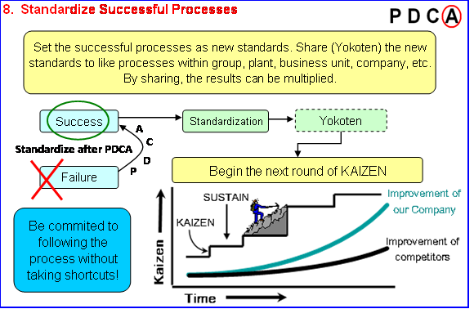
STEP 8: STANDARDIZE SUCCESSFUL PROCESSES
Start the Next Round of Kaizen
Continually improve the level and value of the output to achieve the “Ideal State”.
Yokoten Is Sharing Learning Across The Organization
59
Notes:
59

Slide 60
STEP 8: STANDARDIZE SUCCESSFUL PROCESSES
Standardized work
KAIZEN
Visualize Problem
Pursue Root Cause
Shorten maintenance time and raise the number of KAIZEN
Continues Improvement
SUSTAIN
Improvement of our Company
KAIZEN
Improvement of competitors
Time
We must Kaizen to stay competitive or our competition will pass us.

Slide 61
STEP 8: STANDARDIZE SUCCESSFUL PROCESSES
Promote sharing of the new precedent
This is the new standard way.
Physically demonstrate
Understand the thinking
YOKOTEN
Ask yourself: Who else could benefit from this new standard? Other Cells, Departments, Business Units?

Slide 62
Step 8: Standardize Successful Process – Toyota Example
Begin next Kaizen and Teach Others!

Slide 63
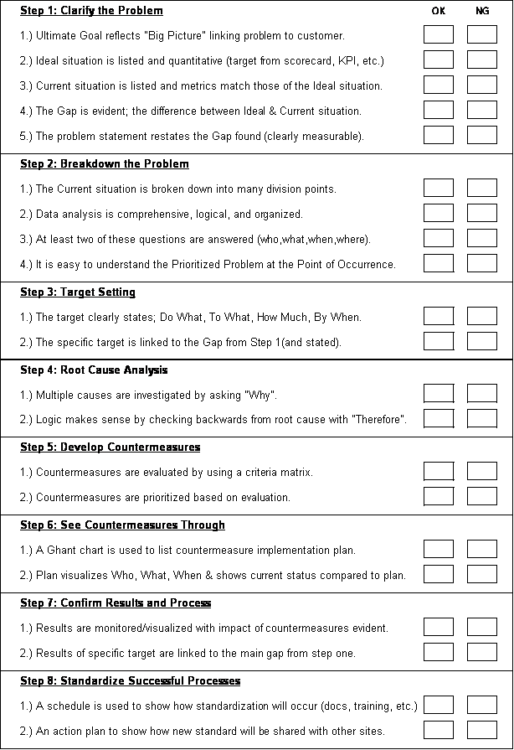
8-STEP RCCM SUSTAINMENT
Process Audit
Select RCCM Champions at each site to mentor others in RCCM use
  Champions must present their 8-Step RCCM to a leadership panel prior to coaching others
RCCM Champions and Leaders need to Audit active 8-Step process
A3s.
Rigor Around Process Compliance
63

Slide 64
SUMMARY TAKE AWAYS
8-Step RCCM process is critical for Pentair to take our performance to the next level.
Effective 8-Step RCCM problem solving will accelerate SQDCC improvement, growth, and innovation
It applies to all functions, not just Operations
There are eight critical steps in the process, including:
  Prioritized Problem at the Point of Occurrence….use Pareto analysis
  Genchi Genbutsu at the Gemba – “go see with your own eyes at the place the work is done”
  Identify the underlying root cause(s)…use 5 WHYS
  Focus counter measures on root causes
  Yokoten – shared knowledge
Improve 8-Step RCCM quality using Champions and audits.
8-Step RCCM Thinking Will Enable Sustainable Improvement

Slide 65
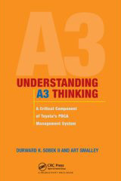


WHERE TO GO FOR MORE INSIGHT/SUPPORT
Suggested Reading:
  “Understanding A3 Thinking: A Critical Component of Toyota’s PDCA System” by Durward K. Sobek II
  “The A3 Workbook: Unlock Your Problem Solving Mind” by Daniel D. Matthews
  “The Toyota Way” and “The Toyota Way Fieldbook” by Jeffey K Liker and David Meier
More Resources Available To Help Improve Your Problem Solving

Slide 66
What is good enough?

